Slide 1
Python Language Basics
Introduction
Data Types
NumPy
Packages
Pandas

Slide 2
Python Language Basics
Operators
Data Types
Control Flow and Comprehensions
Functions
Strings
Files and Exception Handling
Multithreaded Programming
Object Oriented Programming

Slide 3
Lesson Objectives
Operators and Data Types
Control Flow – Conditionals and Loops
List Comprehensions
Functions and Modular Programming
Strings
Files and Exception Handling
Multithreaded Programming
Object Oriented Programming Concepts

Slide 4
Python Data Types
Introduction
Data Types
NumPy
Packages
Pandas

Slide 5
Operators
Operators
Data Types
Control Flow and Comprehensions
Functions
Strings
Files and Exception Handling
Multithreaded Programming
Object Oriented Programming

Slide 6
Python Operators (Assignments / Boolean)
operation | operator | Example
Assignment | = | a = 10
Logical
And | and | a and b
Or | or | a or b
Not | not | not a

Slide 7
Python Operators (Assignments / Boolean)
operation | operator | Example
Assignment | = | a = 10
Logical
And | and | a and b
Or | or | a or b
Not | not | not a

Slide 8
Python Operators: Arithmetic
Operation | operator | Example
Addition | + | a + b
Subtraction | - | a - b
Multiply | * | a * b
Division | / | a / b
Exponent | ** | a ** 2
modulus | % | 5 % 2 is 1
Integer division | // | 5 // 2 is 2

Slide 9
Python Operators: Arithmetic
Operation | operator | Example
Addition | + | a + b
Subtraction | - | a - b
Multiply | * | a * b
Division | / | a / b
Exponent | ** | a ** 2
modulus | % | 5 % 2 is 1
Integer division | // | 5 // 2 is 2

Slide 10
Python Operators: Bitwise
Operation | operator | Example
Bitwise And | & | a & b
Bitwise Or | | | a | b
Bitwise Xor | ^ | a ^ b
Bitwise 1’s complement | ~ | ~a
Logical shift left | << n | a << 2
Logical Shift Right | >> n | a >> 2

Slide 11
Python Operators: Bitwise
Operation | operator | Example
Bitwise And | & | a & b
Bitwise Or | | | a | b
Bitwise Xor | ^ | a ^ b
Bitwise 1’s complement | ~ | ~a
Logical shift left | << n | a << 2
Logical Shift Right | >> n | a >> 2

Slide 12
Python Operators: Comparison
Comparison | operator | Example
less | < | a < b
Greater | > | a > b
Less than equal | <= | a <= b
Greater than equal | >= | a >= b
Equal | == | a == b
Not equal | != | a != b

Slide 13
Python Operators: Comparison
Comparison | operator | Example
less | < | a < b
Greater | > | a > b
Less than equal | <= | a <= b
Greater than equal | >= | a >= b
Equal | == | a == b
Not equal | != | a != b

Slide 14
Data Types
Operators
Data Types
Control Flow and Comprehensions
Functions
Strings
Files and Exception Handling
Multithreaded Programming
Object Oriented Programming

Slide 15
Python Data Types
Python has no value types or primitive types
Everything is an object.
Objects are referred to by reference.
Even simple integers are references.
Variables are always references
References are untyped. (loose typing)
References can point to anything.
Some types are immutable (can’t be changed)
most numeric types
Strings
tuples

Slide 16
Python Data Types
Python has no value types or primitive types
Everything is an object
Objects are referred to by reference
Even simple integers are references
Variables are always references
References are untyped (loose typing)
References can point to anything
Some types are immutable (can’t be changed)
most numeric types
Strings
tuples

Slide 17
Python Data Types
Scalar
float (3.1)
int (10)
long (10L)
complex (1+3j)
bool (True / False)
str (“hello world”)
Complex
list: [1, 2, 2, 3]
set [1, 2, 3] #No dups
tuple (1,”hello”)
dict {“cat”: 3, “dog”: 4}

Slide 18
Python Data Types
Scalar
float (3.1)
int (10)
complex (1+3j)
bool (True / False)
str (“hello world”)
Complex
list: [1, 2, 2, 3]
set {1, 2, 3} #No dups
tuple (1,”hello”)
dict {“cat”: 3, “dog”: 4}

Slide 19
Converting types
Some types can be auto-converted without a warning
There is a hierarchy:
bool -> int -> long -> float -> complex
Upcasting is never a problem
Downcasting may result in loss of information
Explicit conversion / casting
Casting is accomplished by passing the value to the constructor
Example: int(3.1) # float is passed into the constructor of int
Casting always copies the data and makes a new object

Slide 20
Converting types
Some types can be auto-converted without a warning
There is a hierarchy:
bool -> int -> long -> float -> complex
Upcasting is never a problem
Downcasting may result in loss of information
Explicit conversion / casting
Casting is accomplished by passing the value to the constructor
Example: int(3.1) # float is passed into the constructor of int
Casting always copies the data and makes a new object

Slide 21
Lists
Lists are mutable ordered collection of objects
Can mix and match types (unlike NumPy Arrays)
Slicing : returns copy of sub-list (zero based index)
a[1:3] -- gets [”abc”, 3.1]
a[:] -- gets a copy of the whole list #pythonic way to copy list
a[-3:-1] – goes from three from the end to the last.
a = [1, “abc”, 3.1]
a[1]
"abc”
Notes:
Lists are usually homogeneous in practice

Slide 22
Lists
Lists are mutable ordered collection of objects
Can mix and match types (unlike NumPy Arrays)
Slicing - [m:n] returns copy of sub-list from m to n-1 (zero based index)
>>> a = [1, “abc”, 3.1]
>>> a[0]
1
>>> a.append(“appended element”)
>>> a
[1, 'abc', 3.1, 'appended element’]
>>> a[1:3]
[‘abc’, 3.1]
>>> a[:]
[1, ‘abc’, 3.1]
>>> a[-3:-1]
[1, ‘abc’]

Slide 23
Sets
Sets are an unordered collection of objects, with no dups
Can mix and match types like lists
Sets can be used to de-dup a list
frozenset() is an immutable set
a = {1, “abc”, 3.1} #Note the curly braces
a = list(set(a)) # original order not kept
a = frozenset({’a’,’b’,’c’}) #immutable

Slide 24
Sets
Sets are an unordered collection of objects, with no dupes
Can mix and match types, just like lists
Sets can be used to de-dup a list
Frozen Sets
>>> a = {1, “abc”, 3.1, “abc”, 2, 1, 10, 1}
>>> a
{1, 2, 3.1, 10, 'abc'}
>>> a = [1, “abc”, 3.1, “abc”, 2, 1, 10, 1]
>>> a
[1, 'abc', 3.1, 'abc', 2, 1, 10, 1]
>>> a = list(set(a))
>>> a
[1, 2, 3.1, 10, 'abc']
>>> a = frozenset({“a”, “b”, “c”})

Slide 25
dicts
dicts are groups of key-value pairs
Objects can be of ANY type (mix and match)
>>> a = {“one”: 1, “two”: 2, “three” : 3}
>>> a[“one”]
1

Slide 26
Dictionaries
Dictionaries are groups of key-value pairs
Objects can be of ANY type (mix and match)
>>> a = {“cats”: 8, “dogs”: 3, “tigers” : 2}
>>> a[“dogs”]
3
>>> a[“cats”]
8
>>> stock = {“symbol” : “aapl”, “ask” : 190.1, “sell” : 196.5}
>>> stock
{'symbol': 'aapl', 'ask': 190.1, 'sell': 196.5}
>>> stock[“ask”]
100.1

Slide 27
Named Items in dicts
Here we are creating a list with key=value (or name=value) pairs
>>> stock = {"symbol”:"goog",
"ask”:100.1,
"sell”:100.5}
>>> stock
{'sell': 100.6, 'symbol': 'GOOG', 'ask': 100.1}
# refer data by symbols / names
>>> stock[‘ask’]
100.1

Slide 28
dicts : Adding New Attributes
> stock = {'symbol':'GOOG', 'ask':100.1, 'sell':100.6}
# Add a new attribute using []
> stock[‘company name’] = ‘Google’
> stock[‘exchange’] = ‘NASDAQ’
> stock
{'Company Name': 'Google', 'sell': 100.6, 'symbol': 'GOOG', 'ask': 100.1, 'Exchange': 'NASDAQ'}

Slide 29
Dictionaries: Adding New Attributes
New attributes or key/value pairs can be added as follows
Dictionaries are important in Python
>>> stock = {“symbol” : “aapl”, “ask” : 190.1, “sell” : 196.5}
>>> stock
{'symbol': 'aapl', 'ask': 190.1, 'sell': 196.5}
>>> stock[“company”] = “apple”
>>> stock[“stock”] = “nasdaq”
>>> stock
{'symbol': 'aapl', 'ask': 190.1, 'sell': 196.5, 'company': 'apple', 'stock': 'nasdaq'}

Slide 30
Dictionaries
You can think of a dict as a key-value pairs.
Accessing list elements
By name (most common). e.g. stock[‘price’]
dicts are *IMPORTANT* in Python
Lots of Python functions return dicts as a result.
Need to know how to navigate the dicts.

Slide 31
Tuples
Tuples are groups of data
How is a tuple different from a list?
Tuples are immutable (can’t be changed in any way)
Tuples aren’t able to be iterated over.
Tuples are fixed length
Used for:
Returning more than one thing from a function
Forcing mutable data to be immutable
lambda x : (x, x*2) # returns 2 arguments
a = [1,2,3] # Mutable list of size 3
b = tuple(a) #Immutable tuple of size 3

Slide 32
Tuples
Tuples are groups of data
How is a tuple different from a list?
Tuples are immutable (can’t be changed in any way)
Tuples aren’t able to be iterated over
Tuples are fixed length
Example – To convert 2D to 3D coordinates
>>> p = list(coordinates)
>>> p
[5.3, 4.8]
>>> p.append(3.4)
>>> p
[5.3, 4.8, 3.4]
>>> coordinates = tuple(p)
>>> coordinates
(5.3, 4.8, 3.4)
>>> coordinates = (5.3, 4.8)
>>> coordinates
(5.3, 4.8)
>>> coordinates.append(3.4)
<error>

Slide 33
Tuples
Tuples use cases:
Returning more than one thing from a function
Example – The following returns two entities in a tuple
Forcing mutable data to be immutable
>>> lambda x : (x, x*2)
>>> a = [1,2,3] # Mutable list of size 3
>>> a
[1, 2, 3]
>>> b = tuple(a) # Immutable tuple of size 3
>>> b
(1, 2, 3)

Slide 34
Arrays
Python has no native array functionality
List will serve in a pinch, but is very S-L-O-W
The package numpy introduces a native array,
We will discuss shortly.

Slide 35
Arrays
Python has no native array functionality
List will serve in a pinch, but is very S-L-O-W
The package numpy introduces a native array that we will discuss shortly

Slide 36
Ranges
range(<stop>)
range(5) creates a sequence from 0 to 4
range(<start>, <stop>, <step>)
range(5, 15, 1) creates a sequence from 5 to 14 with a step of 1
range(1, 10, 2) creates a sequence from 1 to 9 with a step of 2
It is more flexible than range(<stop>)
>>> a = list(range(5))
>>> b = list(range(5, 15, 1))
>>> c = list(range(1, 10, 2))
>>> print(a)
[0, 1, 2, 3, 4]
>>> print(b)
[5, 6, 7, 8, 9, 10, 11, 12, 13, 14]
>>> print(c)
[1, 3, 5, 7, 9]

Slide 37
Lab: Python datatypes
Lab
Overview: Quick intro lab to Python
Approximate time: 10 mins
Instructions: 03-languageintro / types

Slide 38
Lab: Python Data Types
Lab
Overview: Introduction Python Data Types
Approximate time: 10 mins
Instructions:
03__pythonLanguageBasics | 3.1-types.ipynb

Slide 39
Ranges
range(5) creates a sequence from 0 to 4
range(start, stop step) function is more flexible
range(1,10, 2) => 1,3,5,7,9
range(0, 0.1, 0.01) => 0.0, 0.01, …, 0.10
More options: ?range

Slide 40
Control Flow and Comprehensions
Operators
Data Types
Control Flow and Comprehensions
Functions
Strings
Files and Exception Handling
Multithreaded Programming
Object Oriented Programming

Slide 41
Blocks in Python
Python does not have curly braces (like Java)
Blocks are delimited by indentation
Whitespace matters! But why?
Because it’s good style to use indentation (in Java too!)
Why not have it do meaning too, instead of just ignored.
Curly braces are redundant, and can cause unexpected errors.
statement:
indented block
indented block
statement:
statements

Slide 42
Control Flow - Blocks in Python
Python does not have curly braces (like Java)
Blocks are delimited by indentation
Whitespace matters! But why?
Because it’s good style to use indentation (in Java too!)
Why not have it do meaning too, instead of just ignored.
Curly braces are redundant, and can cause unexpected errors.
statement:
indented block
indented block
statement:
statements

Slide 43
Control Flow: IF-Else
if (condition or expression):
statements
elif: #else if (note the syntax)
statements
else:
statements

Slide 44
Control Flow – Conditionals - if-elif-else
The following is the syntax for the conditional statement if – elif – else
if (condition or expression):
statements
elif: # else if (note the syntax)
statements
else:
statements

Slide 45
One-liner
Can do a one-liner like this:
This is similar to the c++/Java ternary operator.
But arguably more readable.
isApple = True if fruit=‘Apple’ else False
Notes:
In Java – isApple = (fruit == ‘Apple’) ? true: false

Slide 46
Control Flow – Conditionals - One Liners
It is possible to condense code from an if-else statement into just one line
This is similar to the c++/Java ternary operator, but arguably more readable.
>>> fruit = “Apple”
>>> isAppleFlag = True if fruit == “Apple” else False
>>> isAppleFlag
True
>>> fruit = “Orange”
>>> isAppleFlag = True if fruit == “Apple” else False
>>> isAppleFlag
False

Slide 47
Lab: Conditionals
Lab
Overview: Conditional Statements in Python
lab
Approximate time: 10 mins
Instructions: 03-languageintro / Conditionals

Slide 48
Lab: Python Control Flow - Conditionals
Lab
Overview: Write conditionals in Python
Approximate time: 10 mins
Instructions:
03__pythonLanguageBasics | 3.2-conditionals.ipynb

Slide 49
Control Loops
# for loop
for (x in range(10)): # range generates list print(x)
# while loop
x = 10
while (x >= 0):
print(x) #break, continue work here
x = x - 1

Slide 50
Control Flow – Loops – for and while loops
The following is the syntax for loops in Python
# while loop
x = 10
while (x >= 0):
print(x)
x = x - 1
# for loop
for (x in range(10)):
print(x)
# while loop with break and continue
x = 100
while (x >= 0):
if x%17 == 0:
print(x)
break
else
x -= 1
continue

Slide 51
For loops and lists
For loops are designed to operate over lists
Can also operate over strings
In by itself tests membership in a list
squares = [1, 4, 9, 16]
sum = 0
for num in squares:
sum += num
print sum ## 30
list = [’Tim', ‘Mark', ‘Sujee']
if ‘Sujee' in list:
print ‘Present!'

Slide 52
Control Flow – ‘for’ loops and lists
‘for’ loops are designed to operate over lists
Can also operate over strings
‘in’ by itself tests membership in a list
squares = [1, 4, 9, 16]
sum = 0
for num in squares:
sum += num
print sum
list = [“Tim”, “Mark”, “Sujee”]
if “Sujee” in list:
print ‘Present!'

Slide 53
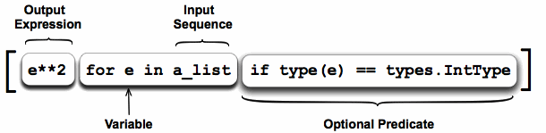
Comprehensions
Python allows an elegant way to iterate through ranges and lists called comprehensions.
a_list = [1, ’4’, 9, ‘a’, 0, 4]
squared_ints = [ e**2 for e in a_list if type(e) == types.IntType ]
print squared_ints
# [ 1, 81, 0, 16 ]

Slide 54
Comprehensions
Python allows an elegant way to iterate through ranges and lists called comprehensions.
The example below is a list comprehension
>>> a_list = [1, “4”, 9, “a”, 0, 4]
>>> squared_ints = [e**2 for e in a_list if “int” in str(type(e))]
>>> print(squared_ints)
[1, 81, 0, 16]

Slide 55
Lab: Control Loops
Lab
Overview: Quick intro lab to Python
Approximate time: 10 mins
Instructions: 03-languageintro / control loops

Slide 56
Lab: Python Control Flow - Loops
Lab
Overview: Write loops in Python
Approximate time: 10 mins
Instructions:
03__pythonLanguageBasics | 3.3-loops.ipynb

Slide 57
Functions
Introduction
Data Types
Functions
Packages
Pandas

Slide 58
Functions
Operators
Data Types
Control Flow and Comprehensions
Functions
Strings
Files and Exception Handling
Multithreaded Programming
Object Oriented Programming

Slide 59
User Functions
Easy to write custom user functions and extend Python.
Return type can by any type : scalar / object / NULL
If end of function is reached without explicit return,
the value of last evaluated expression is returned.
def function (arg1, arg2, …. ):
statements
return(result) #don’t need to say return
Notes:
NOTE: Python also has methods associated with Classes similar to Java.
Functions do not deal with classes. All arguments required by a function must be passed to it explicitly

Slide 60
User Functions
Concept of modular programming
Easy to write custom user functions and extend Python
“return” statements are optional
def function (arg1, arg2, … ):
statements
return(result) # don’t need to say return

Slide 61
User Function Example
def my_max(x,y):
if (x > y)
return x
else
return y

Slide 62
User Functions
Return type can be any type - scalar/complex data type or user defined object / NULL
If end of function is reached without explicit return, the value of last evaluated expression is returned.
def my_max(x,y):
if (x > y):
return x
else:
return y
>>> val = my_max(5,8)
>>> print(val)
8

Slide 63
DocStrings
Functions can (and should) define a docstring
def my_max(x,y)
””” This re-implements the max function
“””
if (x > y):
return x
else :
return y
print(my_max.__doc__)
This re-implements the max function

Slide 64
DocStrings
Functions can (and should) define a docstring to help understand the inputs and outputs of the function
def my_max(x,y):
’’’
This function re-implements the max function
Inputs: Two numbers x, y
Outputs: The maximum of the two numbers
‘’’
if (x > y):
return x
else:
return y
print(my_max.__doc__)
This function re-implements the max function
Inputs: Two numbers x, y
Outputs: The maximum of the two numbers

Slide 65
Lambda Functions
A Lambda is an anonymous function.
Usually used as an argument to another function
Many functions require other functions as parameters:
lambda x : x * x #generate square
people = [(1, ‘Sara’), (2, ‘Bob’), (3, ‘Mary)]
people.sort(key = lambda x: x[1])
[(2, ‘Bob’), (3, ’Mary’), (1, ‘Sara’)]

Slide 66
Map
Performs an operation on any List type:
Map returns a Map object
Convert to list, set, etc.
a = [1, 2, 3, 4, 5]
list(map(lambda x: x * 2, a))
[2, 4, 6, 8, 10]

Slide 67
Lambda
“Lambda Function” is an anonymous function.
Usually used as an argument to another function
The syntax is as follows:
Many functions require other functions as parameters. For example, sorting a list of tuples by the second element in the tuple
lambda <inputs> : <output>
>>> people = [(2, “Sara”), (1, “Bob”), (3, “Mary”)]
>>> people.sort()
>>> print(people)
[(1, 'Bob'), (2, 'Sara'), (3, 'Mary')]
>>> people.sort(key = lambda x: x[1])
>>> print(people)
[(1, ‘Bob’), (3, ’Mary’), (2, ‘Sara’)]

Slide 68
Map
Performs an operation on any list type for each element
The syntax is as follows:
Example:
Note that map returns a map-object that is converted to a list, set, etc.
map(<function>, <sequence>)
>>> a = [1, 2, 3, 4, 5]
>>> a_square = list(map(lambda x : x*x, a))
>>> print(a_square)
[1, 4, 9, 16, 25]

Slide 69
Filter
Performs a filter operation on any list type and returns an object, that can be converted to a sub-list
The syntax is as follows:
Example:
filter(<function>, <sequence>)
>>> a = [1, 2, 3, 4, 5, 6, 7, 8, 9, 10]
>>> a_even = list(filter(lambda x : x%2==0, a))
>>> a_odd = list(filter(lambda x : x%2!=0, a))
>>> print(a_even)
[1, 4, 9, 16, 25]
>>> print(a_odd)
[1, 4, 9, 16, 25]

Slide 70
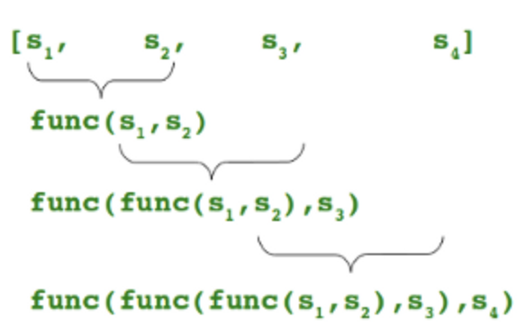
Reduce
Performs a reduce operation on any list type. It continually applies a function to the input sequence and returns a single result.
Example: One line statement to find the maximum number from a sequence
from functools import reduce
reduce(lambda a,b: a if (a>b) else b, [47,11,42,102,13])
102

Slide 71
Lab: Functions
Lab
Overview: Quick intro lab to Python
Approximate time: 10 mins
Instructions: 03-languagebasics / functions

Slide 72
Lab: Functions
Lab
Overview: Write functions in Python
Approximate time: 10 mins
Instructions:
03__pythonLanguageBasics | 3.4-functions.ipynb

Slide 73
Strings
Introduction
Data Types
Strings
Packages
Pandas

Slide 74
Strings
Operators
Data Types
Control Flow and Comprehensions
Functions
Strings
Files and Exception Handling
Multithreaded Programming
Object Oriented Programming

Slide 75
Strings
Class str()
Immutable arrays of variable length
All strings are Unicode in Python 3
No separate “char” type – just single length string
Examples of literal strings:
‘single quotes’
“double quotes”
“””triple quotes are used for very long multi-line strings. ”””
b’\xea’ # binary escaped characters
u’ नमस्ते’ # Unicode characters
r’\d\d’ # Raw string, good for regexes

Slide 76
Strings
Class str()
Immutable arrays of variable length
All strings are Unicode in Python 3
No separate “char” type – just single length string
Examples of literal strings:
‘single quotes’
“double quotes”
“””triple quotes are used for very long multi-line strings. ”””
b’\xea’ # binary escaped characters
u’ नमस्ते’ # Unicode characters
r’\d\d’ # Raw string, good for regexes

Slide 77
Formatted strings
Uses C (not C++) style printf syntax
Use parenthesis for longer formatted strings (as shown above)
text = (“Hi %s! You are visitor %d today” % (”Mary”, 56))

Slide 78
Formatted strings
Python uses C style formatting syntax – printf(x)
Python doesn’t use C++ style formatting syntax – cout << x
Use parenthesis for longer formatted strings (as shown above)
>>> text = (“Hi %s! You are visitor %d today” % (”Mary”, 56))
>>> print(text)
'Hi Mary! You are visitor 56 today'

Slide 79
Referencing Strings
Slice strings similar to lists:
‘Hello’[1:3] : ’el’ # start from 1 up to but not including 3
‘Hello’[1:-1] : ‘ell’ # star t from 1 up to but not including last

Slide 80
Referencing Strings
String slicing is similar to lists:
‘Hello’[1:3] gives ’el’ # start from 1 up to but not including 3
‘Hello’[1:-1] gives ‘ell’ # start from 1 up to but not including last
>>> text = “Hello world!”
>>> print(text)
’Hello world!’
>>> print(text[:])
’Hello world!’
>>> print(text[:5])
’Hello’
>>> print(text[6:11])
’world’
>>> print(text[6:-1])
’world’

Slide 81
String Methods
Method | Description
.lower(), .upper() | Changes to lower/upper case
.strip() | Removes whitespace from beginning and end.
.startswith(’abc’), .endswith(‘abc’) | Tests whether string starts with or ends with the given string.
.isalpha(‘abc’), .isdigit(), .isspace() | Tests if all characters in string are alpha/digit/whitespace
.find(‘abc’) | Finds index of substring ’abc’, or -1 if not found (NOT a regex)
.replace(‘old’, ’new’) | Will replace string with another string (NOT regex)
.split(’,’) | Returns a list of strings given by delimiter (comma in this case) ”a,b,c,d” => [‘a’,’b’,’c’,’d’]
.join([‘a’, ’b’, ’c’, ’d’]) | Will join the list using the string itself as delimiter: “,”.join([‘a’,’b’,’c’,’d’]) => “a,b,c,d”

Slide 82
String Methods
Method | Description
.lower(), .upper() | Changes to lower/upper case
.strip() | Removes whitespace from beginning and end.
.startswith(’abc’), .endswith(‘abc’) | Tests whether string starts with or ends with the given string.
.isalpha(‘abc’), .isdigit(), .isspace() | Tests if all characters in string are alpha/digit/whitespace
.find(‘abc’) | Finds index of substring ’abc’, or -1 if not found (NOT a regex)
.replace(‘old’, ’new’) | Will replace string with another string (NOT regex)
.split(’,’) | Returns a list of strings given by delimiter (comma in this case) ”a,b,c,d” => [‘a’,’b’,’c’,’d’]
.join([‘a’, ’b’, ’c’, ’d’]) | Will join the list using the string itself as delimiter: “,”.join([‘a’,’b’,’c’,’d’]) => “a,b,c,d”

Slide 83
Regular Expressions
Python has very powerful (and fast) regex engine
import re
p = re.compile(r'ab*’, re.IGNORECASE)
p.match(‘abbb’)
<_sre.SRE_Match object; span=(0, 4), match='abbb'>
m = p.match(‘abbb’).group(0) #returns string

Slide 84
Regular Expressions
Python has very powerful (and fast) regex engine
There are many functions like
re.match(‘pattern’) – matches regex at beginning of string
re.search(‘pattern’) – matches regex anywhere in string
re.findall(‘pattern’) – matches regex
re.sub(‘pattern’, ‘replace’) – does regex substitution
>>> import re
>>> p = re.compile(r'ab*’, re.IGNORECASE)
>>> p.match(‘abbb’)
<_sre.SRE_Match object; span=(0, 4), match='abbb'>
>>> m = p.match(‘abbb’).group(0)
‘abbb’

Slide 85
Regex
re.match(‘pattern’) – matches regex at beginning of sring
re.search(‘pattern’) – matches regex anywhere in string
re.findall(‘pattern’) – matches regex
re.sub(‘pattern’, ‘replace’) – does regex substtitution

Slide 86
Lab: String
Lab
Overview: Quick intro lab to Python
Approximate time: 10 mins
Instructions: 03-languagebasics / strings

Slide 87
Lab: Strings
Lab
Overview: Play with strings in Python
Approximate time: 10 mins
Instructions:
03__pythonLanguageBasics | 3.5-strings.ipynb

Slide 88
Exceptions
Introduction
Data Types
Exceptions
Packages
Pandas

Slide 89
Files and Exception Handling
Operators
Data Types
Control Flow and Comprehensions
Functions
Strings
Files and Exception Handling
Multithreaded Programming
Object Oriented Programming

Slide 90
Files
Syntax to open a file – txt
Syntax to open a file – csv
filename = “../data/files/file.txt”
with open(filename, 'r') as myfile:
for line in myfile:
print(line)
filename = “../data/files/file.csv”
with open(filename) as myfile:
myfilereader = csv.reader(myfile, delimiter=',')
for row in myfilereader:
print(' '.join(row))

Slide 91
Python Exceptions
Python can throw exceptions
try:
f = open(filename, 'rU')
text = f.read()
f.close()
except IOError:
## If exception, comes here.
sys.stderr.write('problem reading:' + filename)
## Execution continues with the line after the try/except

Slide 92
Python Exception Handling
Python can throw exceptions
Exception handling helps in attempts to open non-existent files, corrupt files etc
try:
with open(filename, 'r') as myfile:
for line in myfile:
print(line)
except IOError:
sys.stderr.write('problem reading:' + filename)
try:
with open(filename, 'r') as myfile:
for line in myfile:
print(line)
except:
print("Sorry! The file either doesn't exist or is corrupt!")

Slide 93
Lab: Files
Lab
Overview: Play with files in Python
Approximate time: 10 mins
Instructions:
03__pythonLanguageBasics | 3.6-files.ipynb

Slide 94
Multithreaded Programming
Introduction
Data Types
Exceptions
Packages
Pandas

Slide 95
Multithreaded Programming
Operators
Data Types
Control Flow and Comprehensions
Functions
Strings
Files and Exception Handling
Multithreaded Programming
Object Oriented Programming

Slide 96
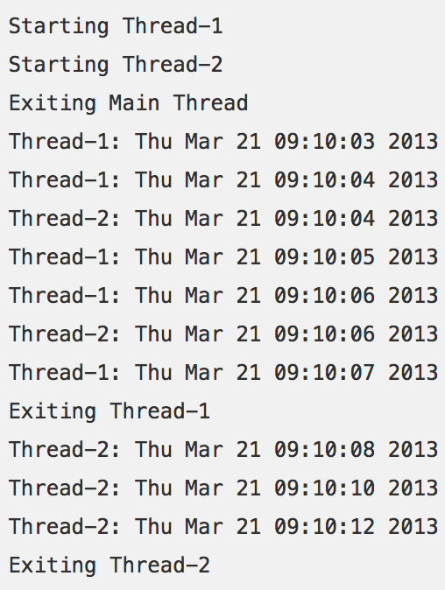
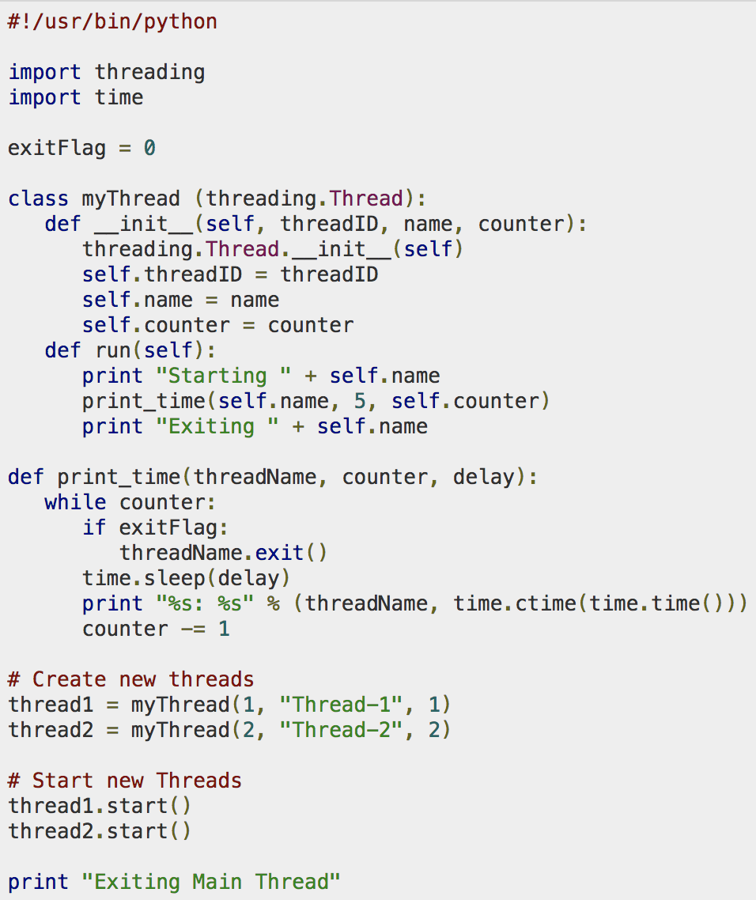
Multithreaded programming
Python supports multithreaded programming
Works very similar to Java (identical interface)
The ’threading’ class is used

Slide 97
Threads
Python supports multithreaded programming
Works very similar to Java (identical interface)
Can also inherit from Thread class
import threading
def dowork():
# Do something
threading.Thread(target=dowork).start()
class MyThread(threading.Thread);
def run(self): #override this
#Do Something

Slide 98
Thread Safety
Immutability is very nice when we have threads!
tuple/frozenset are a thread-safe collection type.
Strings and numerics (ints, floats) are thread-safe.
Otherwise, we need to use lock, semaphore, etc.
class MyThread(threading.Thread):
l = threading.Lock()
def run(self):
with l: # auto acquires/closes the lock.
#Do Something while locking
# Do something else after lock

Slide 99
Events / Callbacks
Python supports Event Handling
Code in event handlers will be run on different thread
Need to keep thread safety in mind in callbacks
Python provides the signal class to handle messaging
import signal, os
def handler(signum, frame):
print('Signal handler called with signal', signum)
raise OSError("Couldn't open device!")
# Set the signal handler and a 5-second alarm
signal.signal(signal.SIGALRM, handler)
signal.alarm(5)
# This open() may hang indefinitely
fd = os.open('/dev/ttyS0', os.O_RDWR)
signal.alarm(0) # Disable the alarm

